Slide 1
How Bad Has COVID-19 Been for the Stock Market?
By: Jacob Avchen, Jacob Hollander, and Salvatore Russo

Slide 2
Question 3:
How Does the Crash Caused by COVID-19
Compare to the Stock Market Crash of 2008?
* We will first look at the overall time series plots of the 2020 and 2008 crashes for the S&P 500 and the Dow Jones Index in order to represent the market as a whole and how it trended from a month prior to the crashes to a month after the crashes
* Taking the day of the crash as our reference point, we will look at the percentage decrease and increase from the other days as compared to the days of the crashes
* Compare how the 2020 indexes changed vs how the 2008 indexes changed

Slide 3
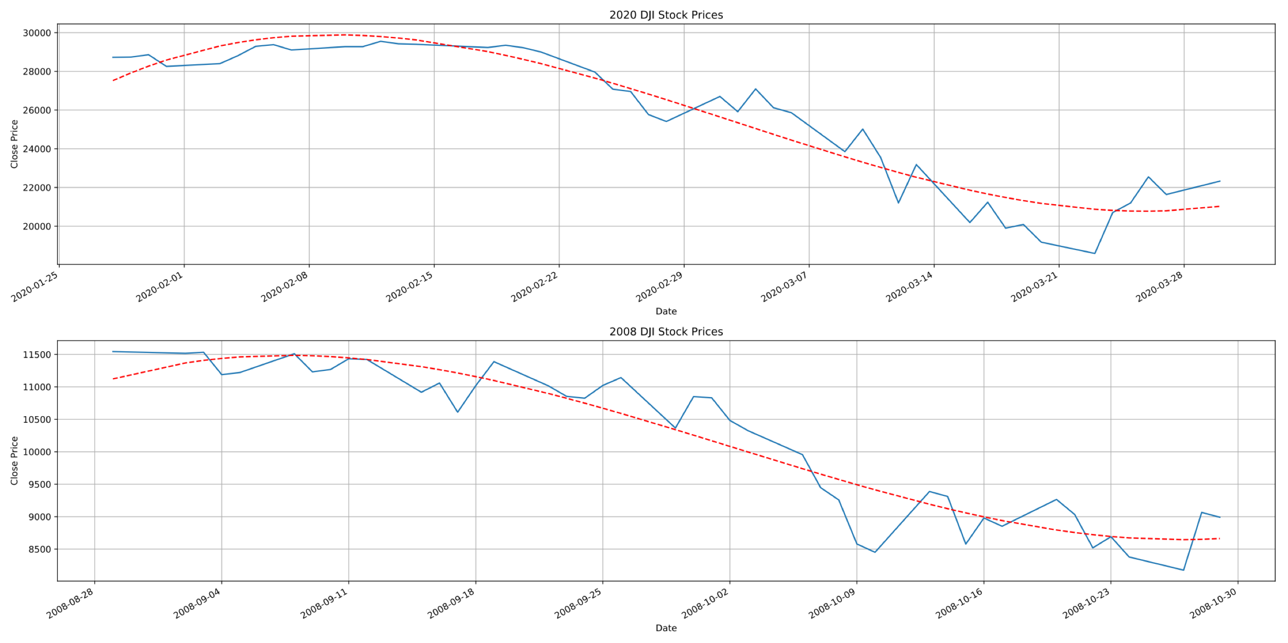
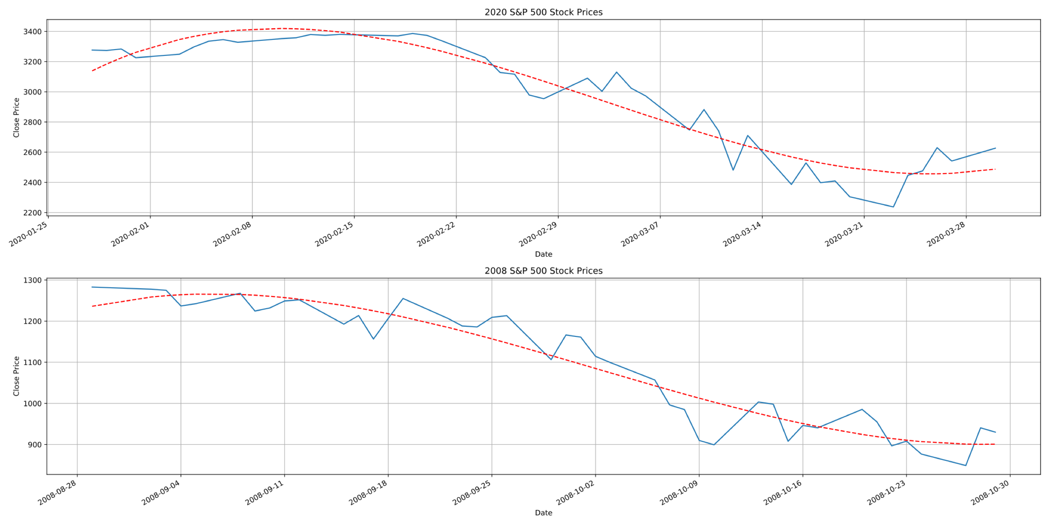
2020 vs 2008 Time Series for DJI and S&P 500

Slide 4
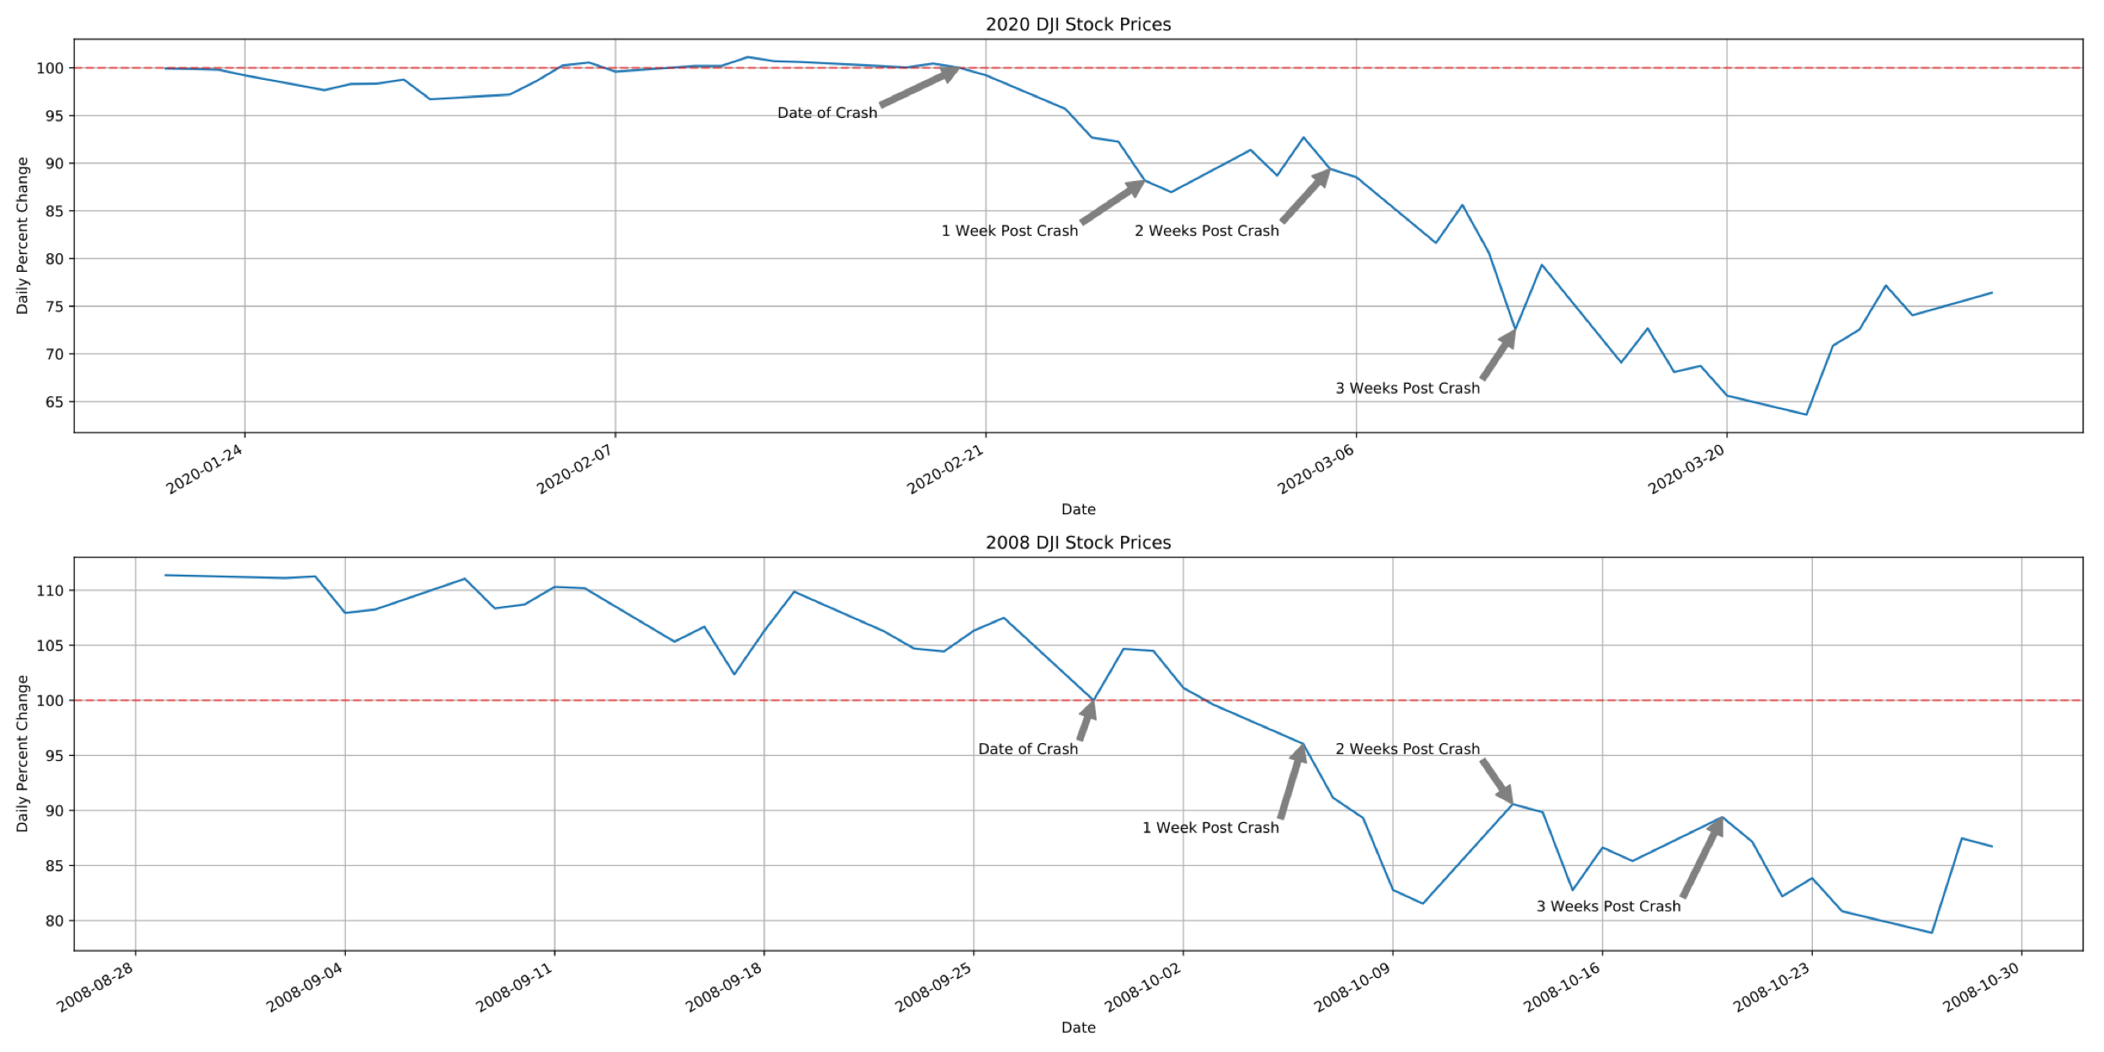
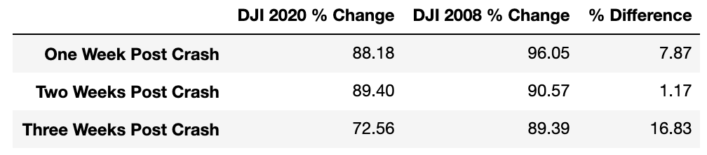
Percent Change Comparison DJI

Slide 5
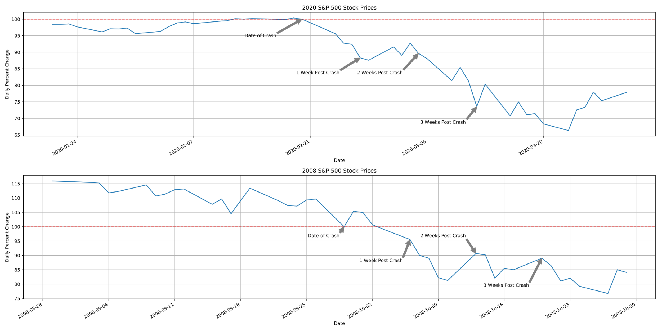
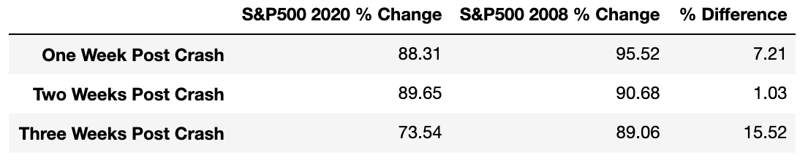
Percent Change Comparison S&P 500

Slide 6
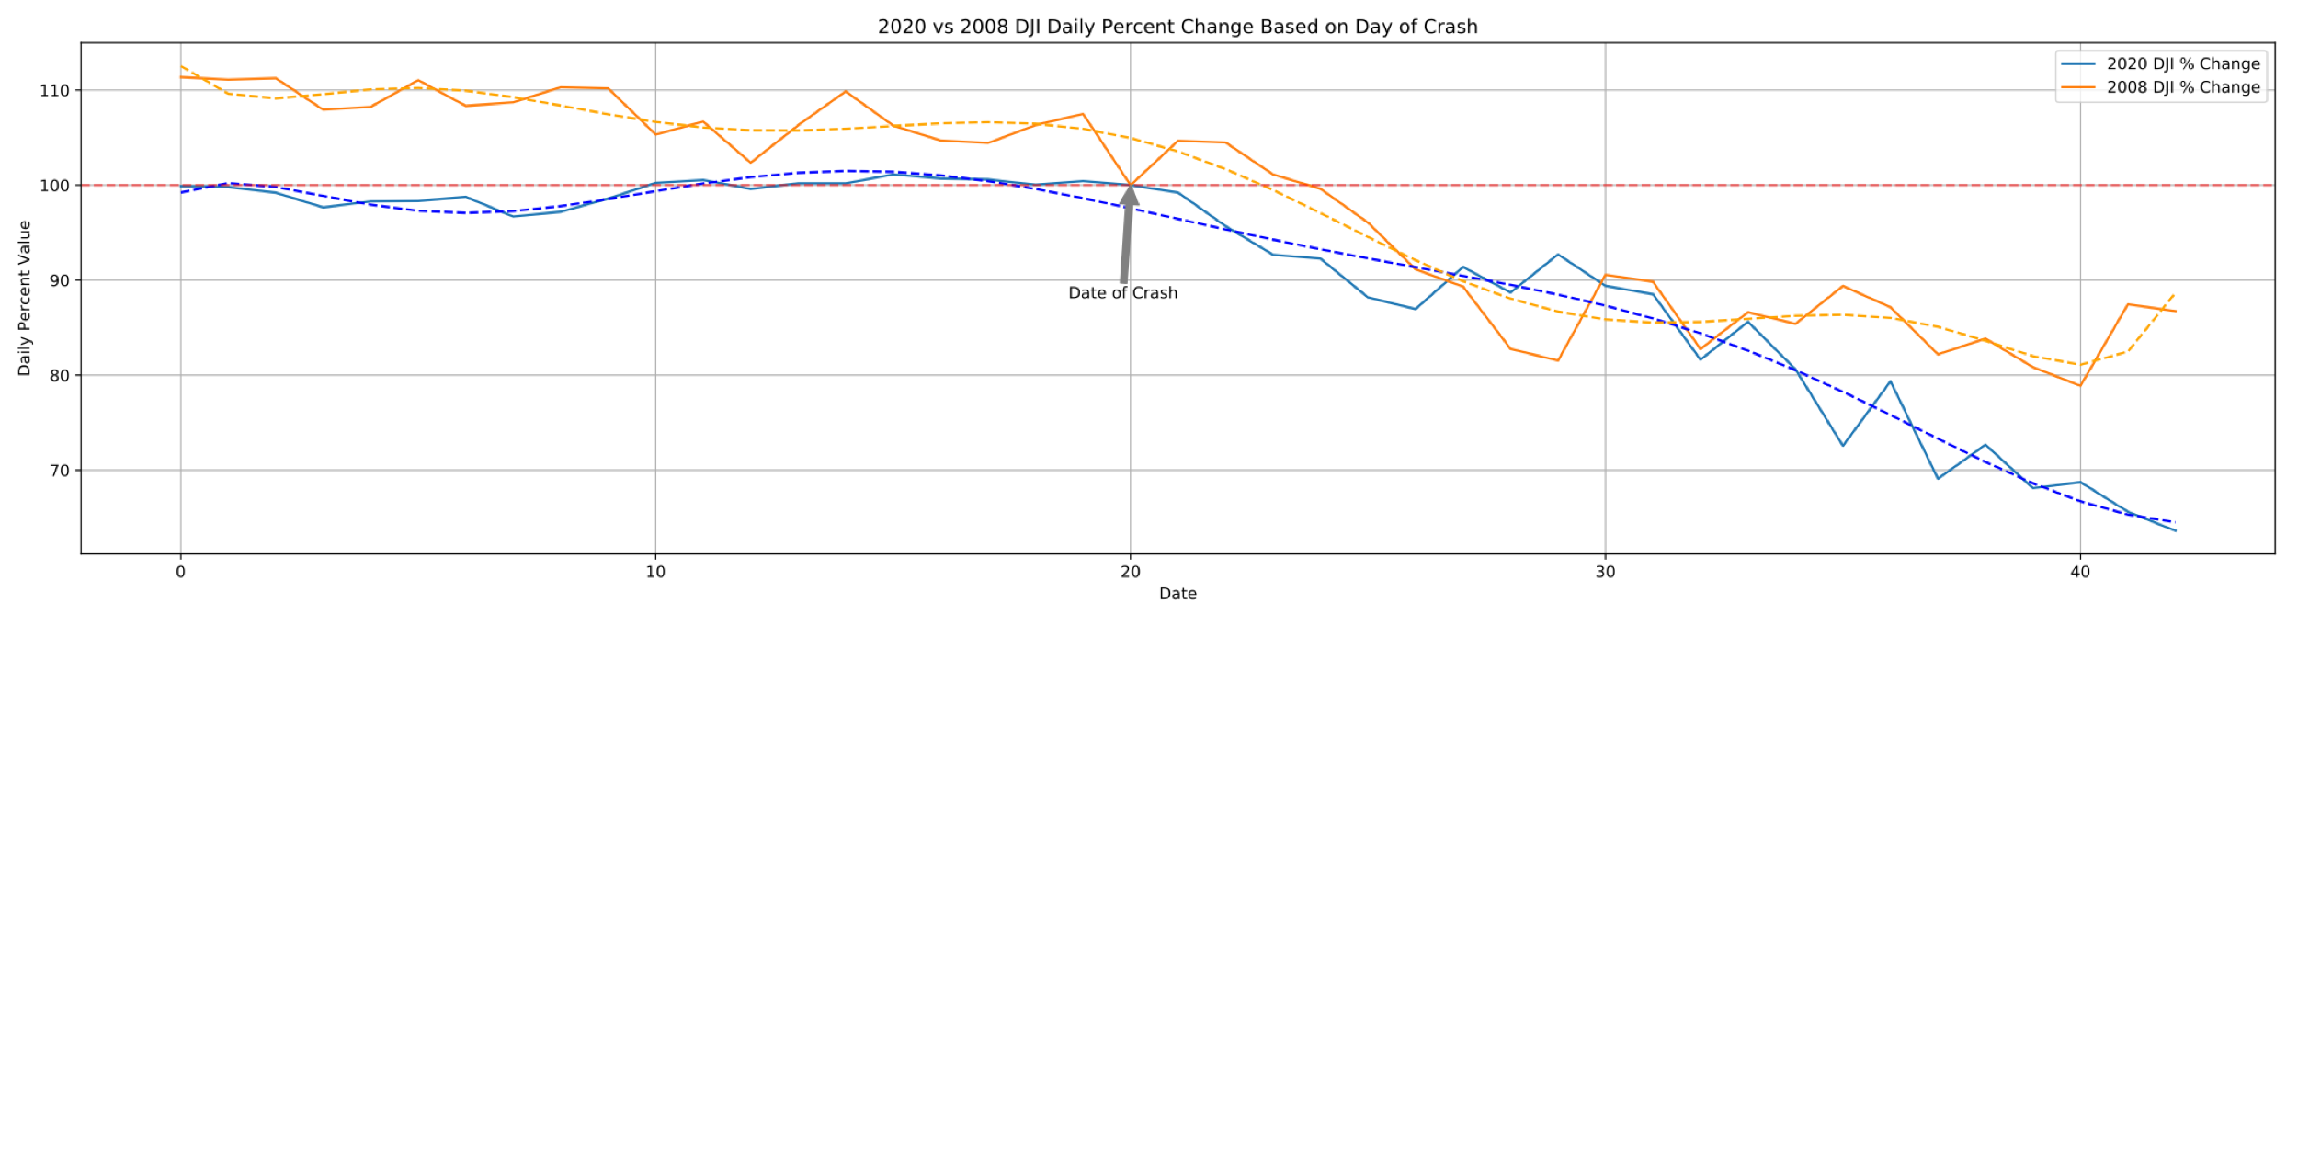
2008 and 2020 date data has been changed to an index value in order to have both crash dates set equal
Follows the same general trend, obviously continuously decreasing over time, however, you can notice as the days since crash increases the 2008 data stabilizes whereas the 2020 data continues to decrease
Shown by the trendlines, the concavity of the two plots oppose one another at roughly 10 days post crash

Slide 7
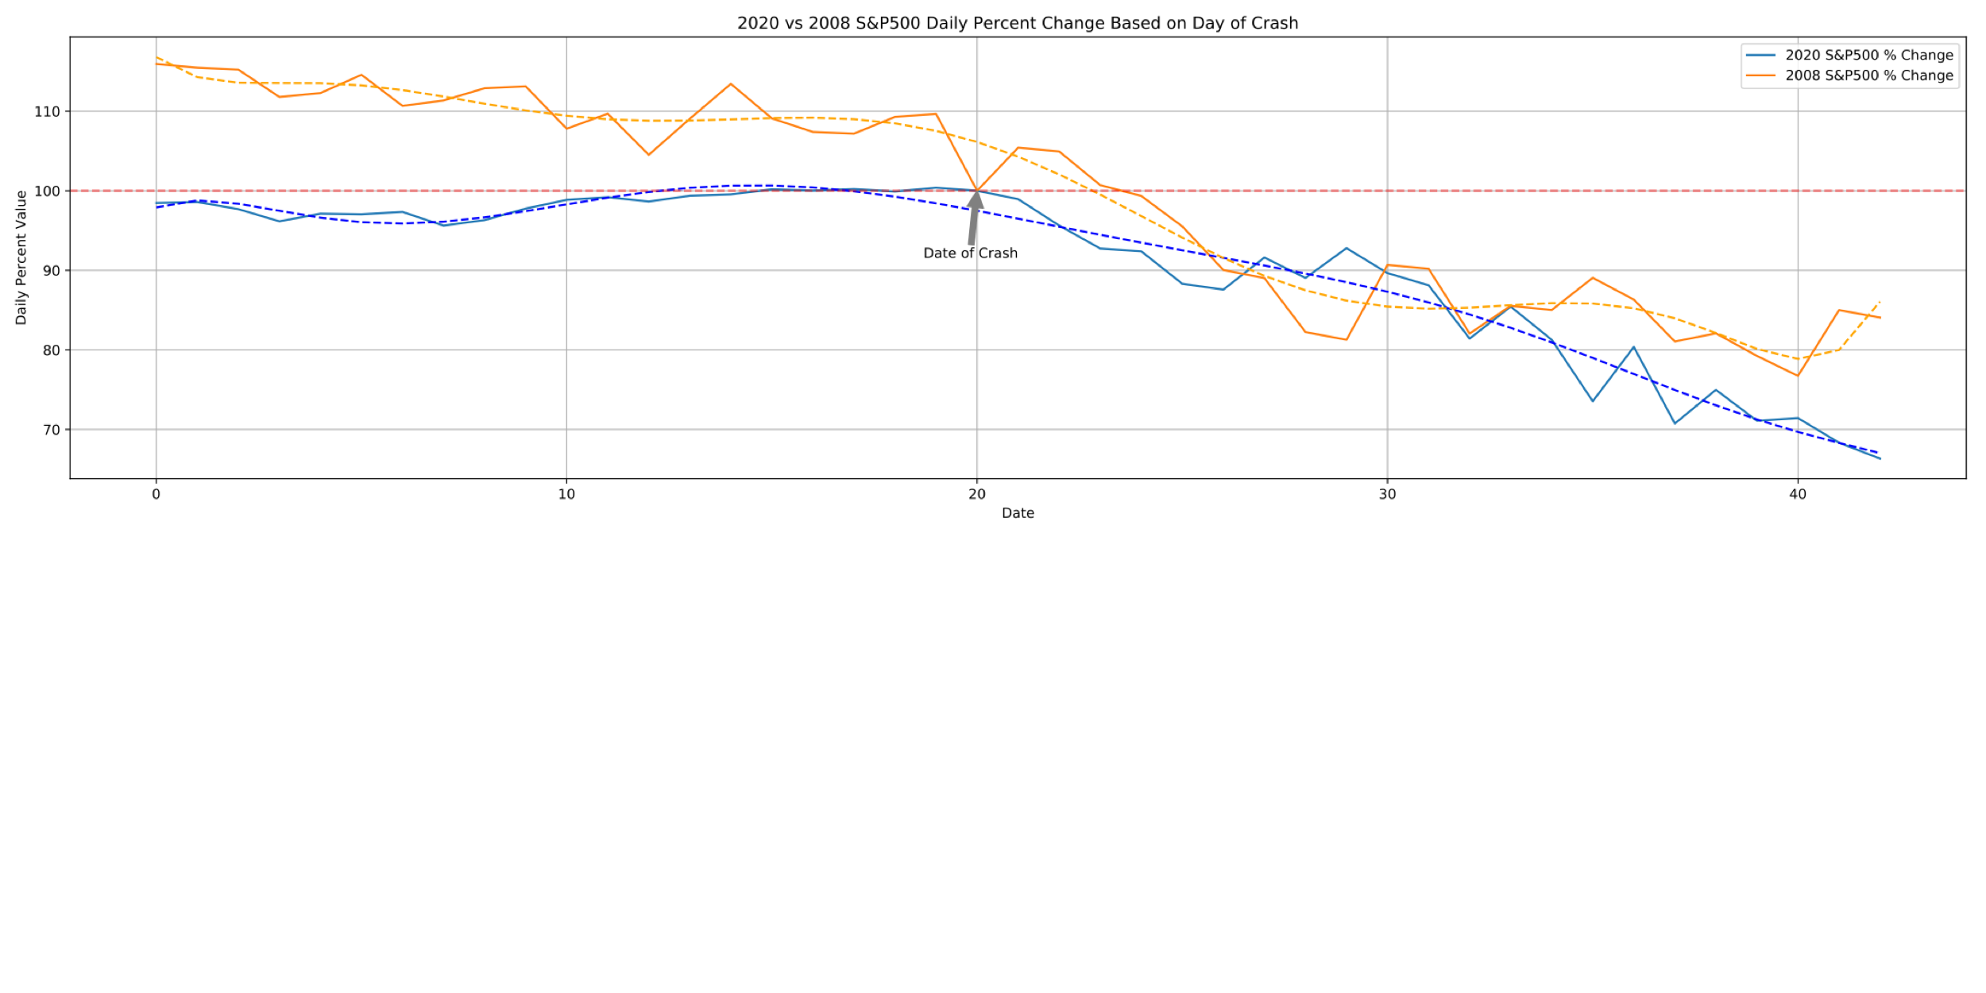
Plotted like that of the Dow Jones Index, we can see the same compared relationships
At roughly 10 days post crash, the 2008 data trendline suggests that the decrease has begun to somewhat stabilize, changing concavity often however decreasing very slightly. The 2020 trendline, however, is still following a linear decline.

Slide 8
Conclusions and Limitations
The general trends of the 2020 index values and percentage drops follow the trends of the 2008 index values and percent drops for days relatively close to crash
Because COVID-19 is still reeking havoc on the world, the markets continue to decline and because there is no real end in sight it is tough to compare this crash to that of 2008, which is why in the previous charts you can see the difference in concavity of the trend lines as the days following the crash continue to increase
Limitations:
Alpha Vantage API does not have access to the NASDAQ index
Compare the index changes of this disaster to other natural disasters
No end in sight for COVID-19

